Slide 1

Use Case: SLA Timer in Power Automate
Ongoing journey… ☺

Slide 2



Requirement
Create a flow that will:
Notify people if a ticket is logged
Remind the responsible parties about tickets logged
Escalate it if not attended to.

Slide 3

Requirement
BUT wait there’s more…
VIP Individuals (Directors, COO, Executives and those higher up in the organisation chart)
Have the privilege of increasing the priority level by one level
Only apply to desktop support type incidents or requests that affect them as an individual.
Service Levels are measured against IT Department Core Business Hours
8:00am – 4:30pm
P1 - which is based on a 24- hour clock.

Slide 4
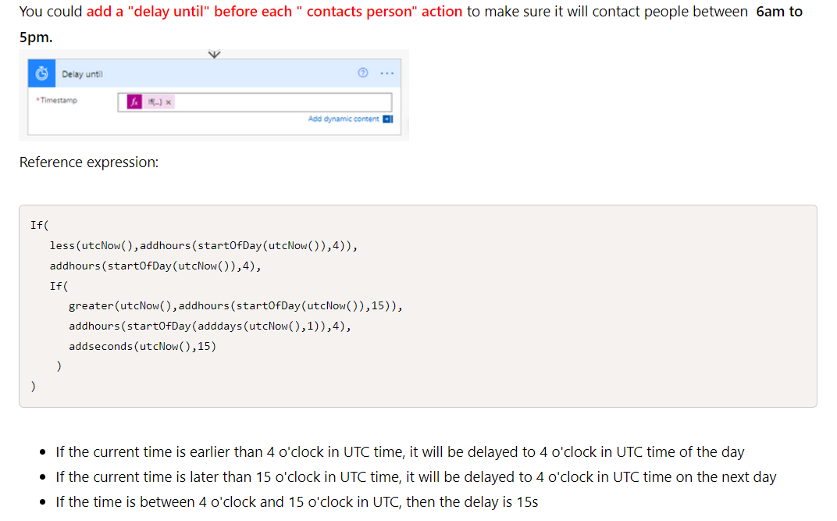

Part of the SOLUTION
https://powerusers.microsoft.com/t5/Building-Flows/Run-timer-just-on-working-hours/td-p/994625

Slide 5



.NET Conf MSDUG Community South Africa 2023
2 Tracks in each city
18 Speakers
Tickets: Johannesburg https://aka.ms/dotnetconfsa-jhb
Tickets: Cape Town https://aka.ms/dotnetconfsa-cpt
Website: https://cptmsdug.dev

Slide 6

Global Power Platform Bootcamp South Africa 2024
2nd of March 2024
Microsoft SA
Call for Speakers: https://sessionize.com/gppbsa/
Register for Event: https://www.meetup.com/jozipug/events/297066384/

